Slide 1
Introducing the AWT: Working with Windows,
Graphics, and Text

Slide 2
AWT
The Abstract Window Toolkit (AWT) was Java’s first GUI framework, and it has been part of Java since version 1.0.
It contains numerous classes and methods that allow you to create windows and simple controls
The latest GUI frameworks are Swing and JavaFX. Which are more powerful.

Slide 3
Although a common use of the AWT is in applets, it is also used to create stand-alone windows that run in a GUI environment.

Slide 4
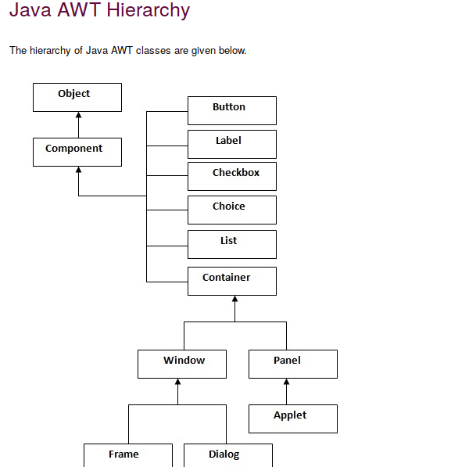

Slide 5
Window Fundamentals
The AWT defines windows according to a class hierarchy that adds functionality and specificity with each level.
The two most common windows are those derived from Panel, which is used by applets, and those derived from Frame, which creates a standard application window.

Slide 6
Component
At the top of the AWT hierarchy is the Component class.
Component is an abstract class that encapsulates all of the attributes of a visual component.
Except for menus, all user interface elements that are displayed on the screen and that interact with the user are subclasses of Component.

Slide 7
It defines over a hundred public methods that are responsible for managing events, such as mouse and keyboard input, positioning and sizing the window, and repainting.
A Component object is responsible for remembering the current foreground and background colors and the currently selected text font.

Slide 8
Container
The Container class is a subclass of Component. It has additional methods that allow other Component objects to be nested within it.
Other Container objects can be stored inside of a Container (since they are themselves instances of Component). This makes for a multileveled containment system.
A container is responsible for laying out (that is, positioning) any components that it contains. It does this through the use of various layout managers

Slide 9
Panel
The Panel class is a concrete subclass of Container. A Panel may be thought of as a recursively nestable, concrete screen component.
Panel is the superclass for Applet.
When screen output is directed to an applet, it is drawn on the surface of a Panel object.
In essence, a Panel is a window that does not contain a title bar, menu bar, or border. This is why you don’t see these items when an applet is run inside a browser.

Slide 10
When you run an applet using an applet viewer, the applet viewer provides the title and border.
Other components can be added to a Panel object by its add( ) method (inherited from Container).
Once these components have been added, you can position and resize them manually using the setLocation( ), setSize( ), setPreferredSize( ), or setBounds( ) methods defined by Component.

Slide 11
Window
A Window object is a top-level window with no borders and no menubar.
A top-level window is not contained within any other object; it sits directly on the desktop.
Generally, you won’t create Window objects directly.
Instead, you will use a subclasses of Window like Frame or Dialog

Slide 12
Frame
Frame encapsulates what is commonly thought of as a “window.”
It is a subclass of Window and has a title bar, menu bar, borders, and resizing corners.
The precise look of a Frame will differ among environments.

Slide 13
Canvas
Although it is not part of the hierarchy for applet or frame windows, there is one other type of window that you will find valuable: Canvas.
Derived from Component, Canvas encapsulates a blank window upon which you can draw.

Slide 14
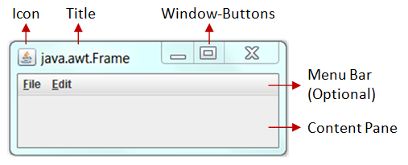

Slide 15
Working with Frame Windows
In addition to the applet, the type of AWT-based window you will most often create is derived from Frame.
You will use it to create child windows within applets, and top-level or child windows for stand-alone applications.

Slide 16
Here are two of Frame’s constructors:
  Frame( ) throws HeadlessException
  Frame(String title) throws HeadlessException
The first form creates a standard window that does not contain a title.
The second form creates a window with the title specified by title.
You cannot specify the dimensions of the window. Instead, you must set the size of the window after it has been created.
A HeadlessException (which is an unchecked exception) is thrown if an attempt is made to create a Frame instance in an environment that does not support user interaction.

Slide 17
Setting the Window’s Dimensions
The setSize( ) method is used to set the dimensions of the window. Its signature is shown here:
  void setSize(int newWidth, int newHeight)
  void setSize(Dimension newSize)
The new size of the window is specified by newWidth and newHeight, or by the width and height fields of the Dimension object passed in newSize.
The dimensions are specified in terms of pixels.

Slide 18
The getSize( ) method is used to obtain the current size of a window. One of its forms is shown here:
  Dimension getSize( )
This method returns the current size of the window contained within the width and height fields of a Dimension object.

Slide 19
Hiding and Showing a Window
After a frame window has been created, it will not be visible until you call setVisible( ). Its signature is shown here:
  void setVisible(boolean visibleFlag)
The component is visible if the argument to this method is true. Otherwise, it is hidden.

Slide 20
Setting a Window’s Title
You can change the title in a frame window using setTitle( ), which has this general form:
  void setTitle(String newTitle)
Here, newTitle is the new title for the window.

Slide 21
Closing a Frame Window
When using a frame window, your program must remove that window from the screen when it is closed, by calling setVisible(false).
To intercept a window-close event, you must implement the windowClosing( ) method of the WindowListener interface.
Inside windowClosing( ), you must remove the window from the screen.

Slide 22
Java AWT Example
There are two ways to create a frame in AWT.
By extending Frame class (inheritance)
By creating the object of Frame class (association)

Slide 23
import java.awt.*;
class First extends Frame{
First(){
setSize(300,300);//frame size 300 width and 300 height
setLayout(null);//no layout manager
setVisible(true);//now frame will be visible, by default not visible
setTitle("My new frame");
}
public static void main(String args[]){
First f=new First();
}}

Slide 24
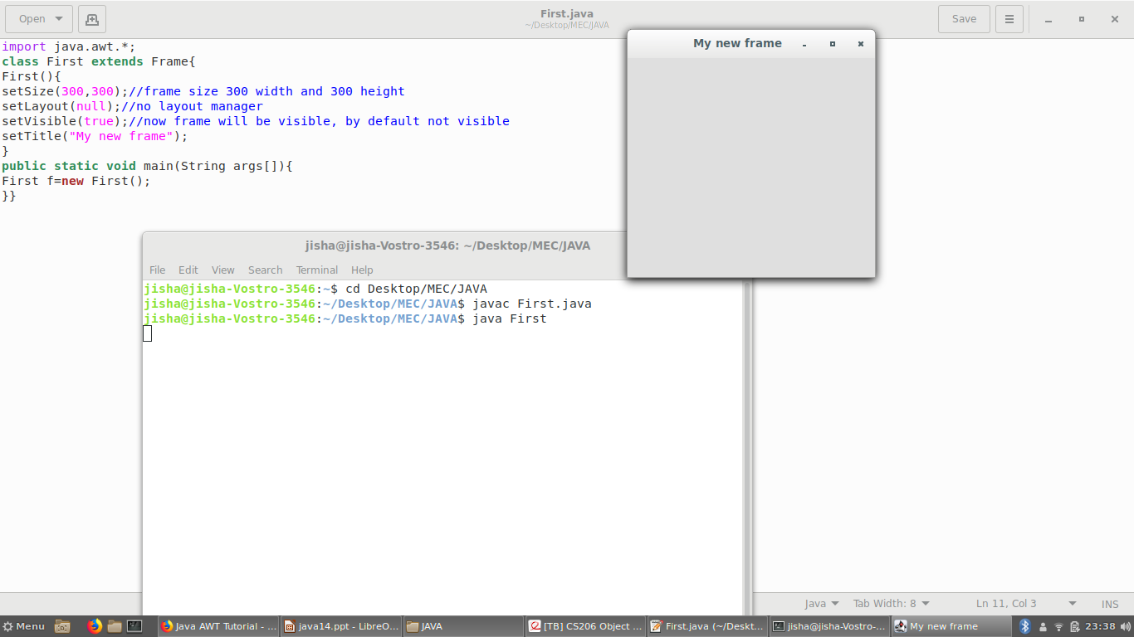

Slide 25
import java.awt.*;
class First2{
First2(){
Frame f=new Frame();
f.setSize(300,300);
f.setLayout(null);
f.setVisible(true);
f.setTitle("My New Frame");
}
public static void main(String args[]){
First2 f=new First2();
}}

Slide 26
import java.awt.*;
class First2{
public static void main(String args[]){
Frame f=new Frame();
f.setSize(300,300);
f.setLayout(null);
f.setVisible(true);
f.setTitle("My New Frame");
}}

Slide 27
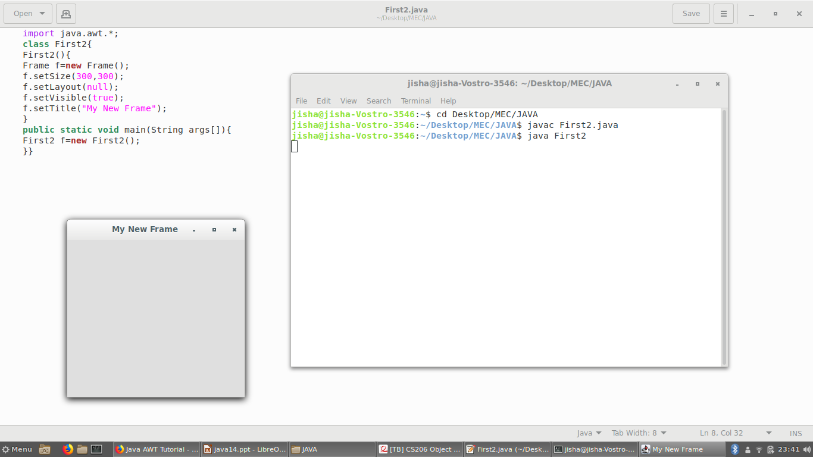

Slide 28
Creating a Frame Window in an AWT-Based Applet
Creating a new frame window from within an AWT-based applet is actually quite easy.
First, create a subclass of Frame.
Next, override any of the standard applet methods, such as init( ), start( ), and stop( ), to show or hide the frame as needed.
Finally, implement the windowClosing( ) method of the WindowListener interface, calling setVisible(false) when the window is closed.

Slide 29
// Create a child frame window from within an applet.
import java.awt.*;
import java.awt.event.*;
import java.applet.*;
/*
<applet code="AppletFrame" width=300 height=50>
</applet>
*/
// Create a subclass of Frame.
class SampleFrame extends Frame {
SampleFrame(String title) {
super(title);

Slide 30
// create an object to handle window events
MyWindowAdapter adapter = new MyWindowAdapter(this);
// register it to receive those events
addWindowListener(adapter);
}
public void paint(Graphics g) {
g.drawString("This is in frame window", 10, 40);
}
}

Slide 31
class MyWindowAdapter extends WindowAdapter {
SampleFrame sampleFrame;
public MyWindowAdapter(SampleFrame sampleFrame) {
this.sampleFrame = sampleFrame;
}
public void windowClosing(WindowEvent we) {
sampleFrame.setVisible(false);
}
}

Slide 32
// Create frame window.
public class AppletFrame extends Applet {
Frame f;
public void init() {
f = new SampleFrame("A Frame Window");
f.setSize(250, 250);
f.setVisible(true);
}
public void start() {
f.setVisible(true);
}

Slide 33
public void stop() {
f.setVisible(false);
}
public void paint(Graphics g) {
g.drawString("This is in applet window", 10, 20);
}
}

Slide 34
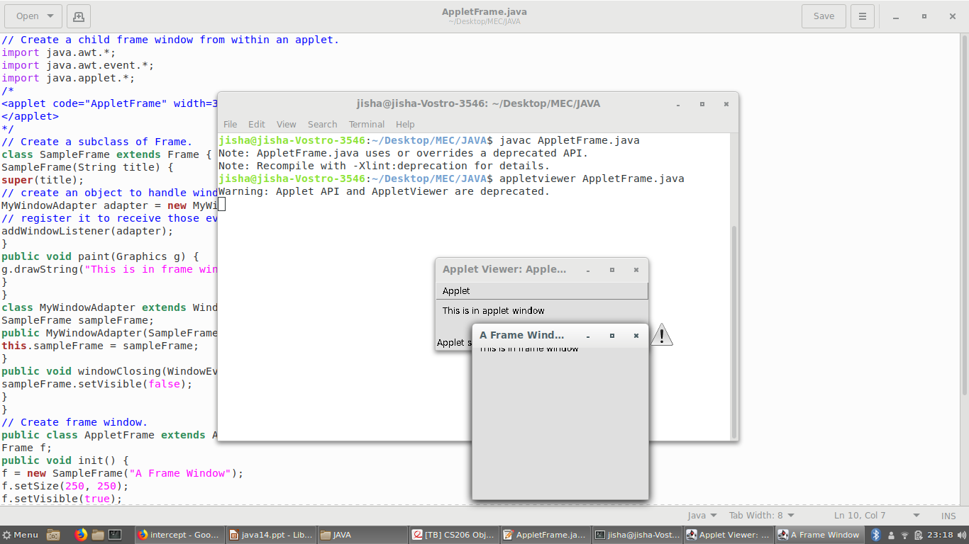

Slide 35
Introducing Graphics
The AWT includes several methods that support graphics.
All graphics are drawn relative to a window. This can be the main window of an applet, a child window of an applet, or a stand-alone application window.
The origin of each window is at the top-left corner and is 0,0. Coordinates are specified in pixels.
All output to a window takes place through a graphics context.

Slide 36
A graphics context is encapsulated by the Graphics class. Here are two ways in which a graphics context can be obtained:
• It is passed to a method, such as paint( ) or update( ), as an argument.
• It is returned by the getGraphics( ) method of Component.
Among other things, the Graphics class defines a number of methods that draw various types of objects, such as lines, rectangles, and arcs. In several cases, objects can be drawn edge-only or filled.
Objects are drawn and filled in the currently selected color, which is black by default. When a graphics object is drawn that exceeds the dimensions of the window, output is automatically clipped.

Slide 37
Drawing Lines
Lines are drawn by means of the drawLine( ) method, shown here:
void drawLine(int startX, int startY, int endX, int endY )
drawLine( ) displays a line in the current drawing color that begins at startX, startY and ends at endX, endY.

Slide 38
Drawing Rectangles
The drawRect( ) and fillRect( ) methods display an outlined and filled rectangle, respectively.They are shown here:
void drawRect(int left, int top, int width, int height)
void fillRect(int left, int top, int width, int height)
The upper-left corner of the rectangle is at left, top. The dimensions of the rectangle are specified by width and height.

Slide 39
To draw a rounded rectangle, use drawRoundRect( ) or fillRoundRect( ), both shown here:
void drawRoundRect(int left, int top, int width, int height, int xDiam, int yDiam)
void fillRoundRect(int left, int top, int width, int height, int xDiam, int yDiam)
A rounded rectangle has rounded corners.
The dimensions of the rectangle are specified by width and height. The diameter of the rounding arc along the X axis is specified by xDiam. The diameter of the rounding arc along the Y axis is specified by yDiam.

Slide 40
Drawing Ellipses and Circles
To draw an ellipse, use drawOval( ). To fill an ellipse, use fillOval( ). These methods are shown here:
void drawOval(int left, int top, int width, int height)
void fillOval(int left, int top, int width, int height)
The ellipse is drawn within a bounding rectangle whose upper-left corner is specified by left, top and whose width and height are specified by width and height. To draw a circle, specify a square as the bounding rectangle.

Slide 41
Drawing Arcs
Arcs can be drawn with drawArc( ) and fillArc( ), shown here:
void drawArc(int left, int top, int width, int height, int startAngle, int sweepAngle)
void fillArc(int left, int top, int width, int height, int startAngle,
int sweepAngle)
The arc is bounded by the rectangle whose upper-left corner is specified by left, top and whose width and height are specified by width and height.
The arc is drawn from startAngle through the angular distance specified by sweepAngle. Angles are specified in degrees.

Slide 42
Drawing Polygons
It is possible to draw arbitrarily shaped figures using drawPolygon( ) and fillPolygon( ), shown here:
void drawPolygon(int x[ ], int y[ ], int numPoints)
void fillPolygon(int x[ ], int y[ ], int numPoints)
The polygon’s endpoints are specified by the coordinate pairs contained within the x and y arrays.
The number of points defined by these arrays is specified by numPoints.

Slide 43
Demonstrating the Drawing Methods
// Draw graphics elements.
import java.awt.*;
import java.applet.*;
/*
<applet code="GraphicsDemo" width=350 height=700>
</applet>
*/
public class GraphicsDemo extends Applet {
public void paint(Graphics g) {

Slide 44
// Draw lines.
g.drawLine(0, 0, 100, 90);
g.drawLine(0, 90, 100, 10);
g.drawLine(40, 25, 250, 80);
// Draw rectangles.
g.drawRect(10, 150, 60, 50);
g.fillRect(100, 150, 60, 50);
g.drawRoundRect(190, 150, 60, 50, 15, 15);
g.fillRoundRect(280, 150, 60, 50, 30, 40);

Slide 45
// Draw Ellipses and Circles
g.drawOval(10, 250, 50, 50);
g.fillOval(90, 250, 75, 50);
g.drawOval(190, 260, 100, 40);
// Draw Arcs
g.drawArc(10, 350, 70, 70, 0, 180);
g.fillArc(60, 350, 70, 70, 0, 75);
// Draw a polygon
int xpoints[] = {10, 200, 10, 200, 10};
int ypoints[] = {450, 450, 650, 650, 450};
int num = 5;
g.drawPolygon(xpoints, ypoints, num);
} }

Slide 46
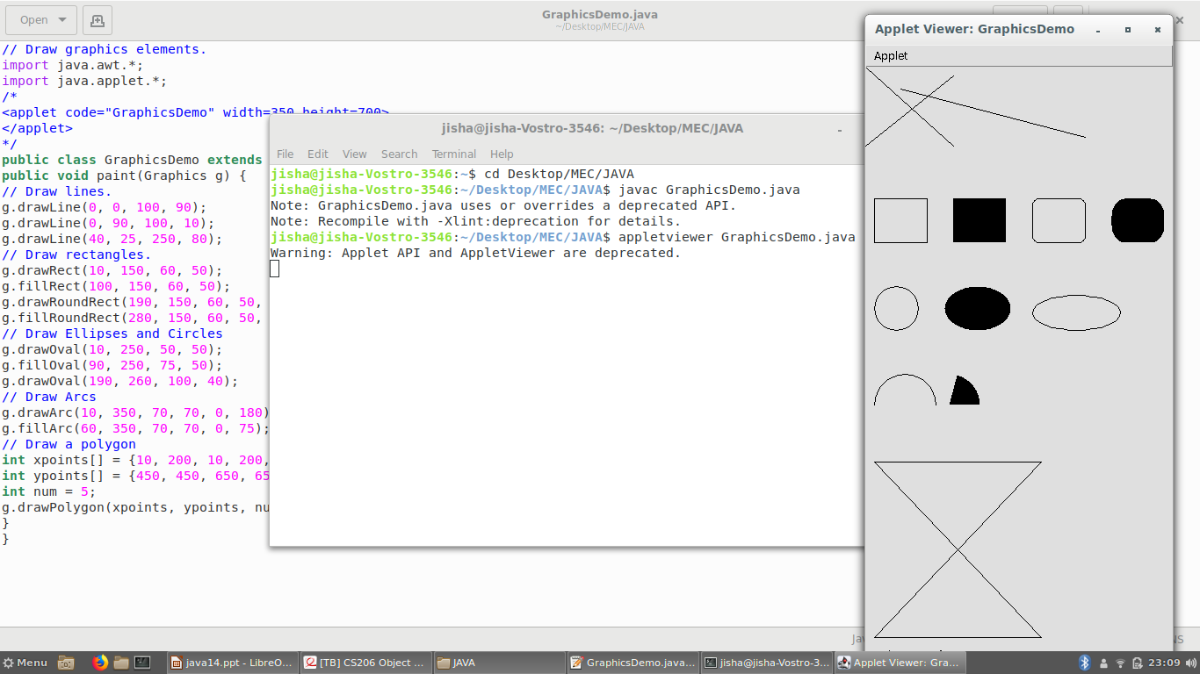

Slide 47
Sizing Graphics
Often, you will want to size a graphics object to fit the current size of the window in which it is drawn.
To do so, first obtain the current dimensions of the window by calling getSize( ) on the window object.
It returns the dimensions of the window encapsulated within a Dimension object.
Once you have the current size of the window, you can scale your graphical output accordingly.

Slide 48
// Resizing output to fit the current size of a window.
import java.applet.*;
import java.awt.*;
import java.awt.event.*;
/*
<applet code="ResizeMe" width=200 height=200>
</applet>
*/
public class ResizeMe extends Applet {
final int inc = 25;
int max = 500;
int min = 200;
Dimension d;

Slide 49
public void paint(Graphics g) {
d = getSize();
g.drawLine(0, 0, d.width-1, d.height-1);
g.drawLine(0, d.height-1, d.width-1, 0);
g.drawRect(0, 0, d.width-1, d.height-1);
}
}

Slide 50
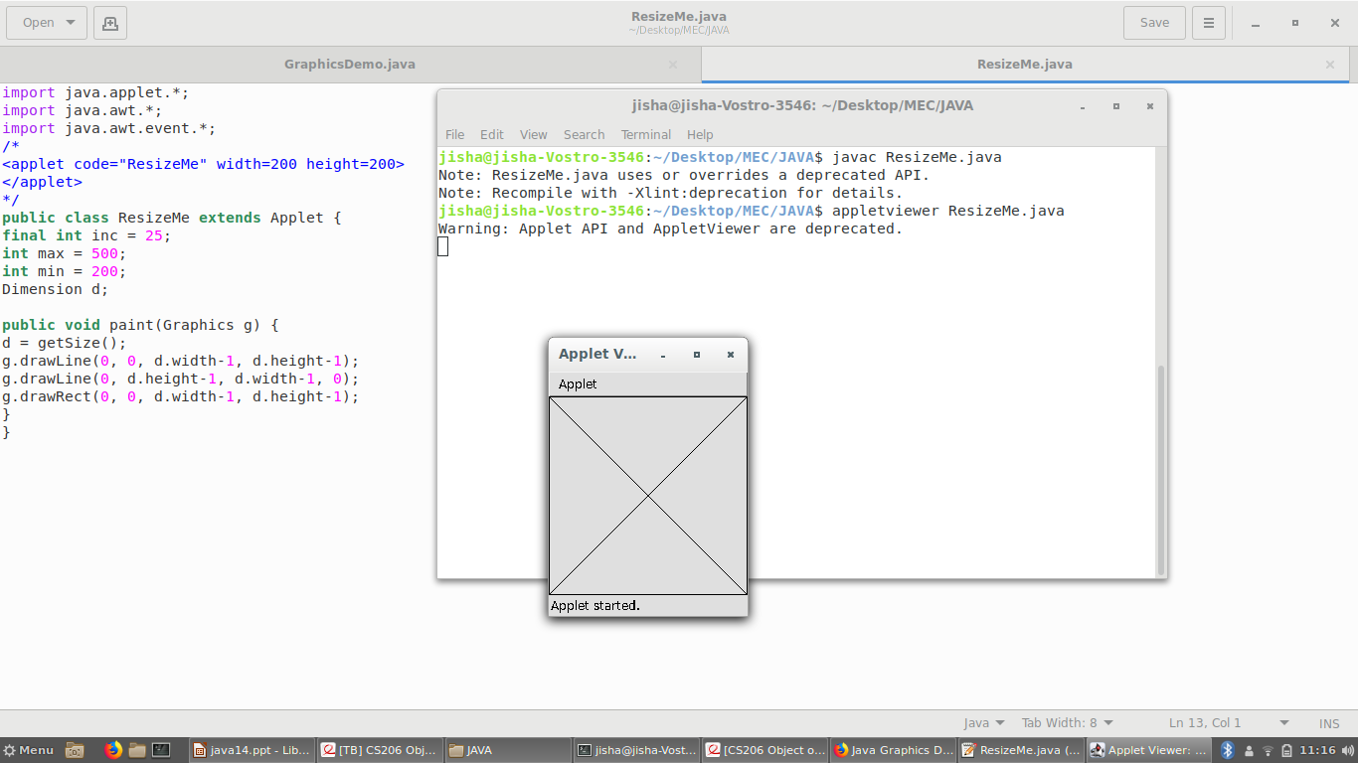

Slide 51
Working with Color
Java supports color in a portable, device-independent fashion.
The AWT color system allows you to specify any color you want.
It then finds the best match for that color, given the limits of the display hardware currently executing your program or applet. Thus, your code does not need to be concerned with the differences in the way color is supported by various hardware devices.
Color is encapsulated by the Color class.

Slide 52
Three commonly used constructors are shown here:
Color(int red, int green, int blue)
Color(int rgbValue)
Color(float red, float green, float blue)
The first constructor takes three integers that specify the color as a mix of red, green, and
blue. These values must be between 0 and 255, as in this example:
new Color(255, 100, 100); // light red

Slide 53
The second color constructor takes a single integer that contains the mix of red, green, and blue packed into an integer.
The integer is organized with red in bits 16 to 23, green in bits 8 to 15, and blue in bits 0 to 7.
The final constructor, Color(float, float, float), takes three float values (between 0.0 and 1.0) that specify the relative mix of red, green, and blue.
Once you have created a color, you can use it to set the foreground and/or background color by using the setForeground( ) and setBackground( ) methods
You can also select it as the current drawing color.

Slide 54
Color Methods
Using Hue, Saturation, and Brightness
The hue-saturation-brightness (HSB) color model is an alternative to red-green-blue (RGB)
for specifying particular colors.
Figuratively, hue is a wheel of color. The hue can be specified with a number between 0.0 and 1.0, which is used to obtain an angle into the color wheel.
Saturation is another scale ranging from 0.0 to 1.0, representing light pastels to intense hues.
Brightness values also range from 0.0 to 1.0, where 1 is bright white and 0 is black.

Slide 55
Color supplies two methods that let you convert between RGB and HSB. They are shown here:
static int HSBtoRGB(float hue, float saturation, float brightness)
static float[ ] RGBtoHSB(int red, int green, int blue, float values[ ])
HSBtoRGB( ) returns a packed RGB value compatible with the Color(int) constructor.
RGBtoHSB( ) returns a float array of HSB values corresponding to RGB integers.

Slide 56
getRed( ), getGreen( ), getBlue( )
You can obtain the red, green, and blue components of a color independently using getRed( ), getGreen( ), and getBlue( ), shown here:
int getRed( )
int getGreen( )
int getBlue( )
Each of these methods returns the RGB color component found in the invoking Color object in the lower 8 bits of an integer.

Slide 57
GetRGB( )
To obtain a packed, RGB representation of a color, use getRGB( ), shown here:
int getRGB( )
Setting the Current Graphics Color
By default, graphics objects are drawn in the current foreground color. You can change this color by calling the Graphics method setColor( ) :
void setColor(Color newColor)
Here, newColor specifies the new drawing color.
You can obtain the current color by calling getColor( ), shown here:
Color getColor( )

Slide 58
// Demonstrate color.
import java.awt.*;
import java.applet.*;
/*
<applet code="ColorDemo" width=300 height=200>
</applet>
*/
public class ColorDemo extends Applet {
// draw lines
public void paint(Graphics g) {
Color c1 = new Color(255, 100, 100);
Color c2 = new Color(100, 255, 100);
Color c3 = new Color(100, 100, 255);

Slide 59
g.setColor(c1);
g.drawLine(0, 0, 100, 100);
g.drawLine(0, 100, 100, 0);
g.setColor(c2);
g.drawLine(40, 25, 250, 180);
g.drawLine(75, 90, 400, 400);
g.setColor(c3);
g.drawLine(20, 150, 400, 40);
g.drawLine(5, 290, 80, 19);

Slide 60
g.setColor(Color.red);
g.drawOval(10, 10, 50, 50);
g.fillOval(70, 90, 140, 100);
g.setColor(Color.blue);
g.drawOval(190, 10, 90, 30);
g.drawRect(10, 10, 60, 50);
g.setColor(Color.cyan);
g.fillRect(100, 10, 60, 50);
g.drawRoundRect(190, 10, 60, 50, 15, 15);
}
}

Slide 61
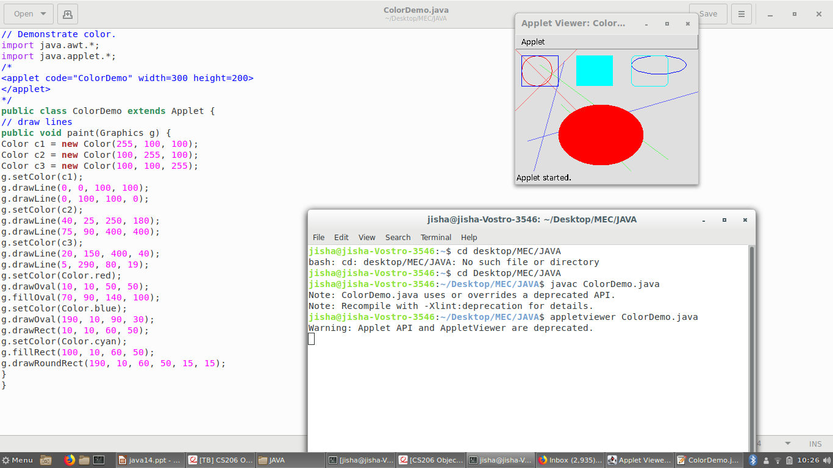

Slide 62
Setting the Paint Mode
The paint mode determines how objects are drawn in a window.
By default, new output to a window overwrites any preexisting contents. However, it is possible to have new objects XORed onto the window by using setXORMode( ), as follows:
void setXORMode(Color xorColor)
Here, xorColor specifies the color that will be XORed to the window when an object is drawn.
The advantage of XOR mode is that the new object is always guaranteed to be visible no matter what color the object is drawn over.

Slide 63
To return to overwrite mode, call setPaintMode( ), shown here:
void setPaintMode( )
In general, you will want to use overwrite mode for normal output, and XOR mode for special purposes.

Slide 64
// Demonstrate XOR mode.
import java.awt.*;
import java.awt.event.*;
import java.applet.*;
/*
<applet code="XOR" width=400 height=200>
</applet>
*/
public class XOR extends Applet {
int chsX=100, chsY=100;

Slide 65
public void paint(Graphics g) {
g.drawLine(0, 0, 100, 100);
g.drawLine(0, 100, 100, 0);
g.setColor(Color.blue);
g.drawLine(40, 25, 250, 180);
g.drawLine(75, 90, 400, 400);
g.setColor(Color.green);
g.drawRect(10, 10, 60, 50);
g.fillRect(100, 10, 60, 50);

Slide 66
g.setColor(Color.red);
g.drawRoundRect(190, 10, 60, 50, 15, 15);
g.fillRoundRect(70, 90, 140, 100, 30, 40);
g.setColor(Color.cyan);
g.drawLine(20, 150, 400, 40);
g.drawLine(5, 290, 80, 19);
// xor cross hairs
g.setXORMode(Color.black);
g.drawLine(chsX-10, chsY, chsX+10, chsY);
g.drawLine(chsX, chsY-10, chsX, chsY+10);
g.setPaintMode();
}
}

Slide 67
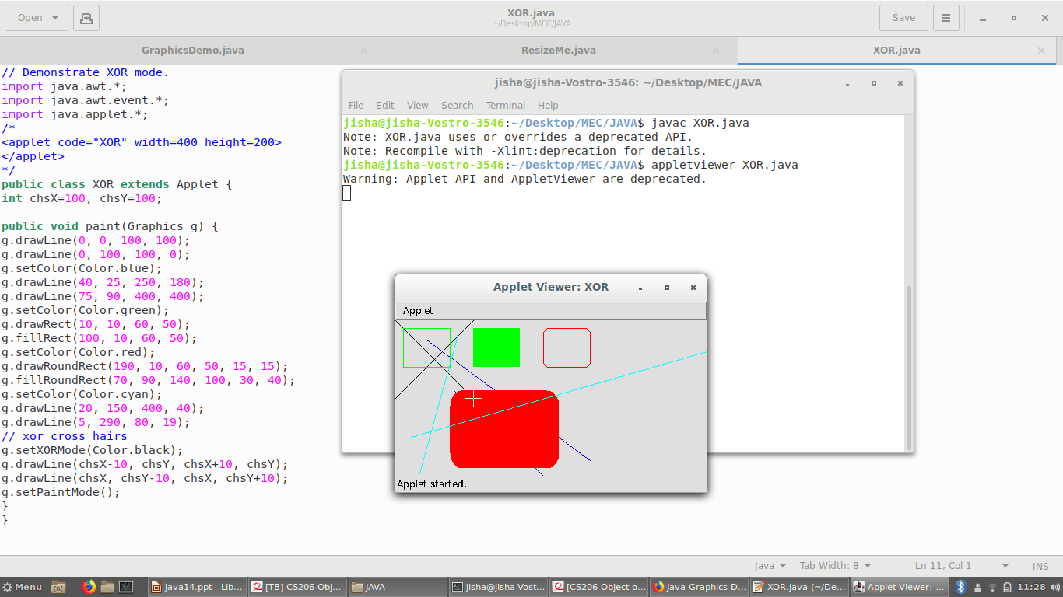

Slide 68
Working with Fonts
The AWT provides flexibility by abstracting font-manipulation operations and allowing for dynamic selection of fonts.
Fonts have a family name, a logical font name, and a face name.
The family name is the general name of the font, such as Courier.
The logical name specifies a name, such as Monospaced, that is linked to an actual font at runtime.
The face name specifies a specific font, such as Courier Italic.

Slide 69
Fonts are encapsulated by the Font class.
The Font class defines these protected variables:
String name Name of the font
float pointSize Size of the font in points
int size Size of the font in points
int style Font style

Slide 70
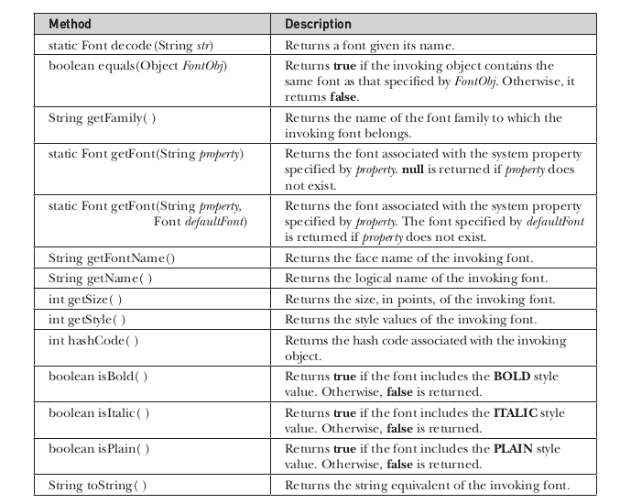

Slide 71
Determining the Available Fonts
When working with fonts, often you need to know which fonts are available on your machine.
To obtain this information, you can use the getAvailableFontFamilyNames( ) method defined by the GraphicsEnvironment class.
This method returns an array of strings that contains the names of the available font families.
In addition, the getAllFonts( ) method is defined by the GraphicsEnvironment class. It is shown here:
Font[ ] getAllFonts( )
This method returns an array of Font objects for all of the available fonts.

Slide 72
Since these methods are members of GraphicsEnvironment, you need a GraphicsEnvironment reference to call them.
You can obtain this reference by using the getLocalGraphicsEnvironment( ) static method, which is defined by GraphicsEnvironment. It is shown here:
static GraphicsEnvironment getLocalGraphicsEnvironment( )

Slide 73
/*
<applet code="ShowFonts" width=550 height=60>
</applet>
*/
import java.applet.*;
import java.awt.*;
public class ShowFonts extends Applet {
public void paint(Graphics g) {
String msg = "";
String FontList[];

Slide 74
GraphicsEnvironment ge = GraphicsEnvironment.getLocalGraphicsEnvironment();
FontList = ge.getAvailableFontFamilyNames();
for(int i = 0; i < FontList.length; i++)
msg += FontList[i] + " ";
g.drawString(msg, 4, 16);
}
}

Slide 75
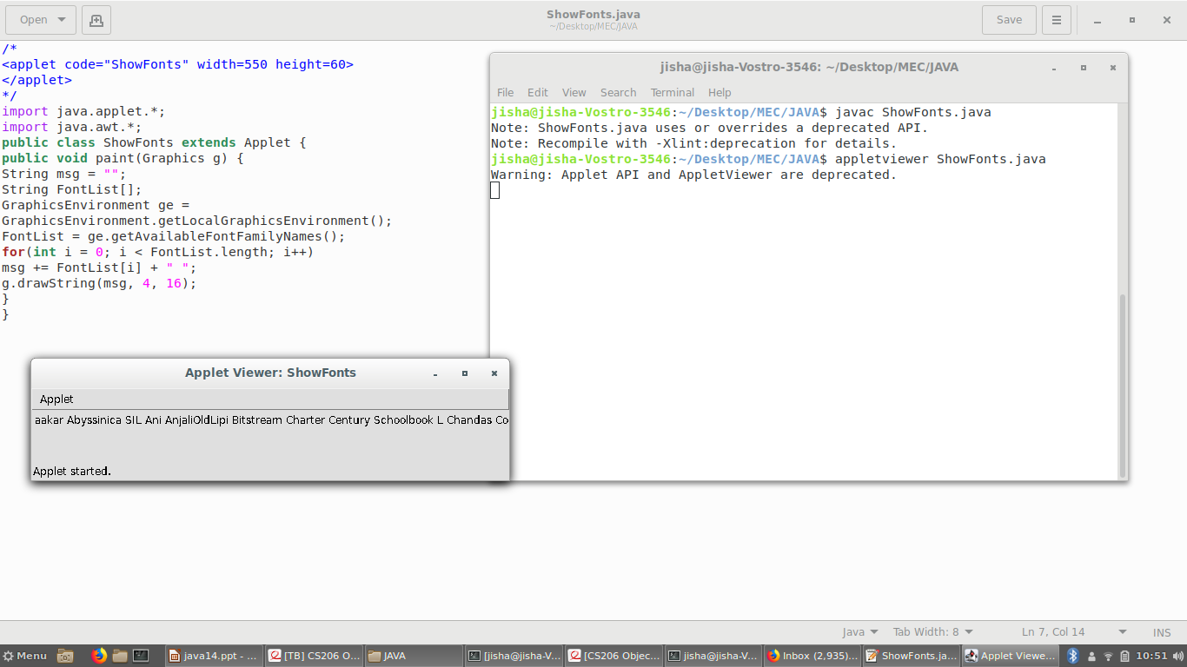

Slide 76
Creating and Selecting a Font
To create a new font, construct a Font object that describes that font. One Font constructor has this general form:
Font(String fontName, int fontStyle, int pointSize)
Here, fontName specifies the name of the desired font. The name can be specified using either the logical or face name.
All Java environments will support the following fonts: Dialog, DialogInput, SansSerif, Serif, and Monospaced.
Dialog is the font used by your system’s dialog boxes. Dialog is also the default if you don’t explicitly set a font.

Slide 77
The style of the font is specified by fontStyle.
It may consist of one or more of these three constants: Font.PLAIN, Font.BOLD, and Font.ITALIC. To combine styles, OR them together. For example, Font.BOLD | Font.ITALIC specifies a bold, italics style.
The size, in points, of the font is specified by pointSize.
To use a font that you have created, you must select it using setFont( ), which is defined by Component. It has this general form:
void setFont(Font fontObj)
Here, fontObj is the object that contains the desired font.

Slide 78
import java.applet.*;
import java.awt.*;
import java.awt.event.*;
/*
<applet code="SampleFonts" width=200 height=100>
</applet>
*/
public class SampleFonts extends Applet {
int next = 0;
Font f;
String msg;

Slide 79
public void init() {
f = new Font("Dialog", Font.PLAIN, 12);
msg = "Dialog";
}
public void paint(Graphics g) {
f = new Font("Dialog", Font.PLAIN, 12);
setFont(f);
msg = "Dialog";
g.drawString(msg, 4, 20);
}
}

Slide 80
Obtaining Font Information
To get the current font by calling getFont( ). This method is defined by the Graphics class, as shown here:
Font getFont( )
Once you have obtained the currently selected font, you can retrieve information about it using various methods defined by Font.

Slide 81
AWT Control Fundamentals
Controls are components that allow a user to interact with your application in various ways
The AWT supports the following types of controls:
• Labels
• Push buttons
• Check boxes
• Choice lists
• Lists
• Scroll bars
• Text Editing
These controls are subclasses of Component.

Slide 82
Adding and Removing Controls
To include a control in a window, you must add it to the window.
To do this, you must first create an instance of the desired control and then add it to a window by calling add( ), which is defined by Container.
The add( ) method has several forms.
Component add(Component compRef)
Here, compRef is a reference to an instance of the control that you want to add.

Slide 83
To remove a control from a window, call remove( ). This method is also defined by Container. Here is one of its forms:
void remove(Component compRef)
Here, compRef is a reference to the control you want to remove.
You can remove all controls by calling removeAll( ).

Slide 84
Labels
The easiest control to use is a label. A label is an object of type Label, and it contains a
string, which it displays. Labels are passive controls that do not support any interaction with the user. Label defines the following constructors:
Label( ) throws HeadlessException
Label(String str) throws HeadlessException
Label(String str, int how) throws HeadlessException

Slide 85
The first version creates a blank label.
The second version creates a label that contains the string specified by str. This string is left-justified.
The third version creates a label that contains the string specified by str using the alignment specified by how.
The value of how must be one of these three constants: Label.LEFT, Label.RIGHT, or Label.CENTER.

Slide 86
You can set or change the text in a label by using the setText( ) method. You can obtain
the current label by calling getText( ). These methods are shown here:
void setText(String str)
String getText( )
For setText( ), str specifies the new label.
For getText( ), the current label is returned.

Slide 87
You can set the alignment of the string within the label by calling setAlignment( ). To
obtain the current alignment, call getAlignment( ). The methods are as follows:
void setAlignment(int how)
int getAlignment( )
Here, how must be one of the alignment constants shown earlier.

Slide 88
// Demonstrate Labels
import java.awt.*;
import java.applet.*;
/*
<applet code="LabelDemo" width=300 height=200>
</applet>
*/
public class LabelDemo extends Applet {
public void init() {
Label one = new Label("One");
Label two = new Label("Two");
Label three = new Label("Three");

Slide 89
// add labels to applet window
add(one);
add(two);
add(three);
}
}

Slide 90
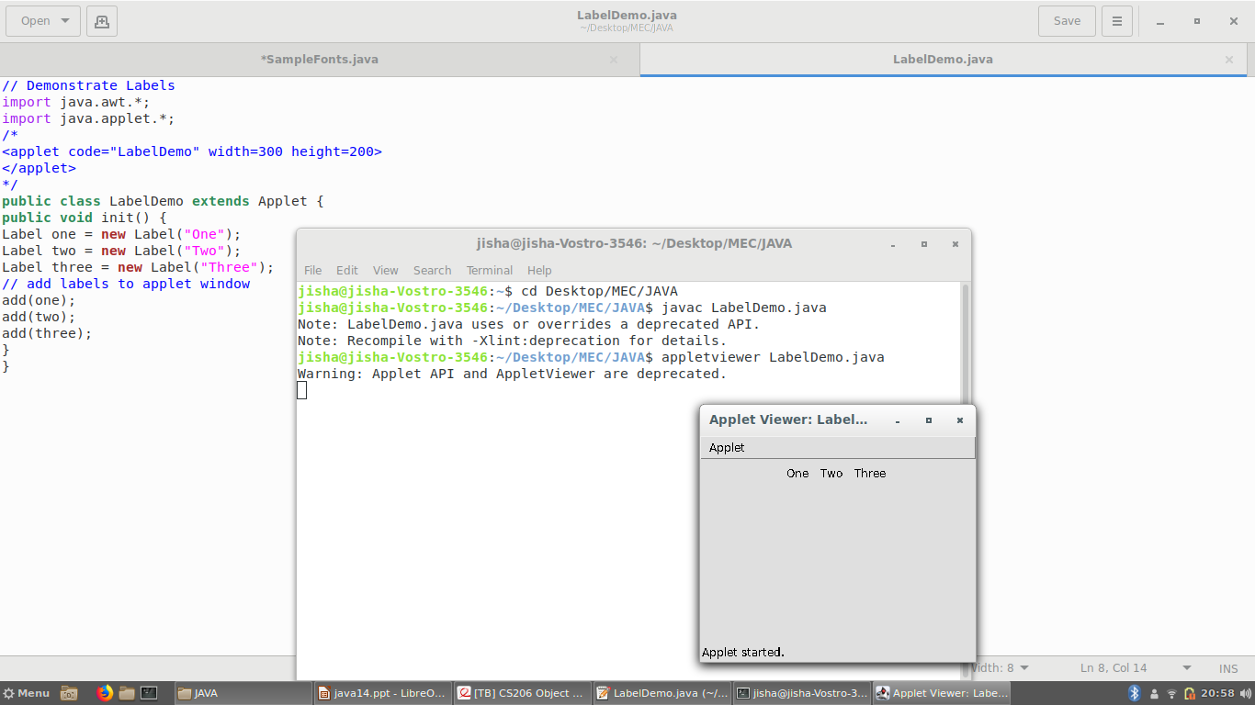

Slide 91
Using Buttons
A push button is a component that contains a label and that generates an event when it is pressed.
Push buttons are objects of type Button. Button defines these two constructors:
Button( ) throws HeadlessException
Button(String str) throws HeadlessException
The first version creates an empty button. The second creates a button that contains str as a label.

Slide 92
After a button has been created, you can set its label by calling setLabel( ). You can retrieve its label by calling getLabel( ). These methods are as follows:
void setLabel(String str)
String getLabel( )
Here, str becomes the new label for the button.

Slide 93
Applying Check Boxes
A check box is a control that is used to turn an option on or off.
It consists of a small box that can either contain a check mark or not.
There is a label associated with each check box that describes what option the box represents.
You change the state of a check box by clicking on it.
Check boxes can be used individually or as part of a group.
Check boxes are objects of the Checkbox class.

Slide 94
Checkbox supports these constructors:
Checkbox( ) throws HeadlessException
Checkbox(String str) throws HeadlessException
Checkbox(String str, boolean on) throws HeadlessException
Checkbox(String str, boolean on, CheckboxGroup cbGroup) throws HeadlessException
Checkbox(String str, CheckboxGroup cbGroup, boolean on) throws HeadlessException

Slide 95
The first form creates a check box whose label is initially blank. The state of the check box is unchecked.
The second form creates a check box whose label is specified by str. The state of the check box is unchecked.
The third form allows you to set the initial state of the check box. If on is true, the check box is initially checked; otherwise, it is cleared.
The fourth and fifth forms create a check box whose label is specified by str and whose group is specified by cbGroup. If this check box is not part of a group, then cbGroup must be null. The value of on determines the initial state of the check box.

Slide 96
To retrieve the current state of a check box, call getState( ). To set its state, call setState( ).
You can obtain the current label associated with a check box by calling getLabel( ). To set the label, call setLabel( ). These methods are as follows:
boolean getState( )
void setState(boolean on)
String getLabel( )
void setLabel(String str)
Here, if on is true, the box is checked. If it is false, the box is cleared. The string passed in str becomes the new label associated with the invoking check box.

Slide 97
CheckboxGroup
It is possible to create a set of mutually exclusive check boxes in which one and only one check box in the group can be checked at any one time.
These check boxes are often called radio buttons, because they act like the station selector on a car radio—only one station can be selected at any one time.
To create a set of mutually exclusive check boxes, you must first define the group to which they will belong and then specify that group when you construct the check boxes.

Slide 98
Check box groups are objects of type CheckboxGroup. Only the default constructor is defined, which creates an empty group.
You can determine which check box in a group is currently selected by calling getSelectedCheckbox( ). You can set a check box by calling setSelectedCheckbox( ).
These methods are as follows:
Checkbox getSelectedCheckbox( )
void setSelectedCheckbox(Checkbox which)
Here, which is the check box that you want to be selected. The previously selected check box will be turned off.

Slide 99
Choice Controls
The Choice class is used to create a pop-up list of items from which the user may choose.
Thus, a Choice control is a form of menu. When inactive, a Choice component takes up only enough space to show the currently selected item.
When the user clicks on it, the whole list of choices pops up, and a new selection can be made.
Each item in the list is a string that appears as a left-justified label in the order it is added to the Choice object.

Slide 100
Choice defines only the default constructor, which creates an empty list.
To add a selection to the list, call add( ). It has this general form:
void add(String name)
Here, name is the name of the item being added. Items are added to the list in the order in
which calls to add( ) occur.

Slide 101
To determine which item is currently selected, you may call either getSelectedItem( ) or
getSelectedIndex( ). These methods are shown here:
String getSelectedItem( )
int getSelectedIndex( )
The getSelectedItem( ) method returns a string containing the name of the item.
getSelectedIndex( ) returns the index of the item. The first item is at index 0. By default, the first item added to the list is selected.

Slide 102
To obtain the number of items in the list, call getItemCount( ). You can set the currently selected item using the select( ) method with either a zero-based integer index or a string that will match a name in the list. These methods are shown here:
int getItemCount( )
void select(int index)
void select(String name)
Given an index, you can obtain the name associated with the item at that index by calling getItem( ), which has this general form:
String getItem(int index)
Here, index specifies the index of the desired item.

Slide 103
Using Lists
The List class provides a compact, multiple-choice, scrolling selection list.
Unlike the Choice object, which shows only the single selected item in the menu, a List object can be constructed to show any number of choices in the visible window.
It can also be created to allow multiple selections.

Slide 104
List provides these constructors:
List( ) throws HeadlessException
List(int numRows) throws HeadlessException
List(int numRows, boolean multipleSelect) throws HeadlessException
The first version creates a List control that allows only one item to be selected at any one time.
In the second form, the value of numRows specifies the number of entries in the list that will always be visible (others can be scrolled into view as needed).
In the third form, if multipleSelect is true, then the user may select two or more items at a time. If it is false, then only one item may be selected.

Slide 105
To add a selection to the list, call add( ). It has the following two forms:
void add(String name)
void add(String name, int index)
Here, name is the name of the item added to the list.
The first form adds items to the end of the list.
The second form adds the item at the index specified by index. Indexing begins at zero. You can specify –1 to add the item to the end of the list.

Slide 106
For lists that allow only single selection, you can determine which item is currently selected by calling either getSelectedItem( ) or getSelectedIndex( ). These methods are shown here:
String getSelectedItem( )
int getSelectedIndex( )
The getSelectedItem( ) method returns a string containing the name of the item.
If more than one item is selected, or if no selection has yet been made, null is returned.
GetSelectedIndex( ) returns the index of the item. The first item is at index 0. If more than one item is selected, or if no selection has yet been made, –1 is returned.

Slide 107
For lists that allow multiple selection, you must use either getSelectedItems( ) or getSelectedIndexes( ), shown here, to determine the current selections:
String[ ] getSelectedItems( )
int[ ] getSelectedIndexes( )
getSelectedItems( ) returns an array containing the names of the currently selected items.
getSelectedIndexes( ) returns an array containing the indexes of the currently selected items.

Slide 108
To obtain the number of items in the list, call getItemCount( ). You can set the currently selected item by using the select( ) method with a zero-based integer index.
These methods are shown here:
int getItemCount( )
void select(int index)
Given an index, you can obtain the name associated with the item at that index by calling getItem( ), which has this general form:
String getItem(int index)
Here, index specifies the index of the desired item.

Slide 109
Managing Scroll Bars
Scroll bars are used to select continuous values between a specified minimum and maximum.
Scroll bars may be oriented horizontally or vertically. A scroll bar is actually a composite of several individual parts.
Each end has an arrow that you can click to move the current value of the scroll bar one unit in the direction of the arrow.
The current value of the scroll bar relative to its minimum and maximum values is indicated by the slider box (or thumb) for the scroll bar.

Slide 110
Scroll bars are encapsulated by the Scrollbar class.
Scrollbar defines the following constructors:
Scrollbar( ) throws HeadlessException
Scrollbar(int style) throws HeadlessException
Scrollbar(int style, int initialValue, int thumbSize, int min, int max)
throws HeadlessException

Slide 111
The first form creates a vertical scroll bar.
The second and third forms allow you to specify the orientation of the scroll bar.
If style is Scrollbar.VERTICAL, a vertical scroll bar is created.If style is Scrollbar.HORIZONTAL, the scroll bar is horizontal.
In the third form of the constructor, the initial value of the scroll bar is passed in initialValue. The number of units represented by the height of the thumb is passed in thumbSize. The minimum and maximum values for the scroll bar are specified by min and max.

Slide 112
If you construct a scroll bar by using one of the first two constructors, then you need to set its parameters by using setValues( ), shown here, before it can be used:
void setValues(int initialValue, int thumbSize, int min, int max)
The parameters have the same meaning as they have in the third constructor just described.

Slide 113
To obtain the current value of the scroll bar, call getValue( ). It returns the current
setting. To set the current value, call setValue( ). These methods are as follows:
int getValue( )
void setValue(int newValue)
Here, newValue specifies the new value for the scroll bar. When you set a value, the slider box inside the scroll bar will be positioned to reflect the new value.

Slide 114
You can also retrieve the minimum and maximum values via getMinimum( ) and
getMaximum( ), shown here:
int getMinimum( )
int getMaximum( )
They return the requested quantity.
By default, 1 is the increment added to or subtracted from the scroll bar each time it is scrolled up or down one line. You can change this increment by calling setUnitIncrement( ).
By default, page-up and page-down increments are 10. You can change this value by calling setBlockIncrement( ). These methods are shown here:
void setUnitIncrement(int newIncr)
void setBlockIncrement(int newIncr)

Slide 115
Using a TextField
The TextField class implements a single-line text-entry area, usually called an edit control.
Text fields allow the user to enter strings and to edit the text using the arrow keys, cut and
paste keys, and mouse selections. TextField is a subclass of TextComponent.

Slide 116
TextField defines the following constructors:
TextField( ) throws HeadlessException
TextField(int numChars) throws HeadlessException
TextField(String str) throws HeadlessException
TextField(String str, int numChars) throws HeadlessException
The first version creates a default text field.
The second form creates a text field that is numChars characters wide.
The third form initializes the text field with the string contained in str.
The fourth form initializes a text field and sets its width.

Slide 117
TextField (and its superclass TextComponent) provides several methods that allow you to utilize a text field.
To obtain the string currently contained in the text field, call getText( ).
To set the text, call setText( ). These methods are as follows:
String getText( )
void setText(String str)
Here, str is the new string.

Slide 118
The user can select a portion of the text in a text field. Also, you can select a portion of text under program control by using select( ).
Your program can obtain the currently selected text by calling getSelectedText( ). These methods are shown here:
String getSelectedText( )
void select(int startIndex, int endIndex)
getSelectedText( ) returns the selected text. The select( ) method selects the characters beginning at startIndex and ending at endIndex –1.

Slide 119
You can control whether the contents of a text field may be modified by the user by calling setEditable( ).
You can determine editability by calling isEditable( ). These methods
are shown here:
boolean isEditable( )
void setEditable(boolean canEdit)
isEditable( ) returns true if the text may be changed and false if not.
In setEditable( ), if canEdit is true, the text may be changed. If it is false, the text cannot be altered.

Slide 120
There may be times when you will want the user to enter text that is not displayed, such as a password. You can disable the echoing of the characters as they are typed by calling setEchoChar( ).
This method specifies a single character that the TextField will display when characters are entered (thus, the actual characters typed will not be shown).
You can check a text field to see if it is in this mode with the echoCharIsSet( ) method. You can retrieve the echo character by calling the getEchoChar( ) method. These methods are as follows:
void setEchoChar(char ch)
boolean echoCharIsSet( )
char getEchoChar( )
Here, ch specifies the character to be echoed. If ch is zero, then normal echoing is restored.

Slide 121
Using a TextArea
Sometimes a single line of text input is not enough for a given task. To handle these situations, the AWT includes a simple multiline editor called TextArea. Following are
the constructors for TextArea:
TextArea( ) throws HeadlessException
TextArea(int numLines, int numChars) throws HeadlessException
TextArea(String str) throws HeadlessException
TextArea(String str, int numLines, int numChars) throws HeadlessException
TextArea(String str, int numLines, int numChars, int sBars) throws HeadlessException

Slide 122
Here, numLines specifies the height, in lines, of the text area, and numChars specifies its width, in characters.
Initial text can be specified by str.
In the fifth form, you can specify the scroll bars that you want the control to have. sBars must be one of these values:
SCROLLBARS_BOTH
SCROLLBARS_NONE
SCROLLBARS_HORIZONTAL_ONLY
SCROLLBARS_VERTICAL_ONLY

Slide 123
TextArea is a subclass of TextComponent. Therefore, it supports the getText( ), setText( ),
getSelectedText( ), select( ), isEditable( ), and setEditable( ) methods described in the
preceding section.
TextArea adds the following editing methods:
void append(String str)
void insert(String str, int index)
void replaceRange(String str, int startIndex, int endIndex)

Slide 124
The append( ) method appends the string specified by str to the end of the current text.
insert( ) inserts the string passed in str at the specified index.
To replace text, call replaceRange( ). It replaces the characters from startIndex to endIndex–1, with the replacement text passed in str.

Slide 125
import java.awt.*;
import java.awt.event.*;
public class MyFrame extends Frame
{
Label myLabel;
Button b1, b2, b3;
Checkbox c1, c2 ,c3,c4;
CheckboxGroup cbg;
Choice myList;
Scrollbar vertSB, horzSB;
TextField name, pass;

Slide 126
MyFrame()
{
setSize(400, 200);
setTitle("My Application");
setLayout(new FlowLayout());
setVisible(true);
myLabel = new Label("This is a label!");
add(myLabel);
b1 = new Button("Red");
b2 = new Button("Green");
b3 = new Button("Blue");
add(b1);
add(b2);
add(b3);

Slide 127
c1 = new Checkbox("Male");
c2 = new Checkbox("Female");
add(c1);
add(c2);
cbg = new CheckboxGroup();
c3 = new Checkbox("Male", cbg, false);
c4 = new Checkbox("Female", cbg, false);
add(c3);
add(c4);

Slide 128
myList = new Choice();
myList.add("CSE");
myList.add("ECE");
myList.add("EEE");
myList.add("IT");
add(myList);
vertSB = new Scrollbar(Scrollbar.VERTICAL, 0, 1, 0, 200);
horzSB = new Scrollbar(Scrollbar.HORIZONTAL, 0, 1, 0, 300);
add(vertSB);
add(horzSB);

Slide 129
Label namep = new Label("Name: ", Label.RIGHT);
Label passp = new Label("Password: ", Label.RIGHT);
name = new TextField(12);
pass = new TextField(8);
pass.setEchoChar('?');
add(namep);
add(name);
add(passp);
add(pass);

Slide 130
String val =
"Java 8 is the latest version of the most\n" +
"widely-used computer language for Internet programming.\n" +
"Building on a rich heritage, Java has advanced both\n" +
"the art and science of computer language design.\n\n" +
"One of the reasons for Java's ongoing success is its\n" +
"course for others to follow.";
TextArea text = new TextArea(val, 10, 30);
add(text);

Slide 131
addWindowListener(new WindowAdapter()
{
public void windowClosing(WindowEvent we)
{
System.exit(0);
}
}
);
}
public static void main(String[] args)
{
MyFrame mf = new MyFrame();
}
}

Slide 132
